Slide 1
Lecture 9: Stream-network spatial models
May 22, 2018
Learning goals:
Understand how to specify a spatial model on a stream network

Slide 3
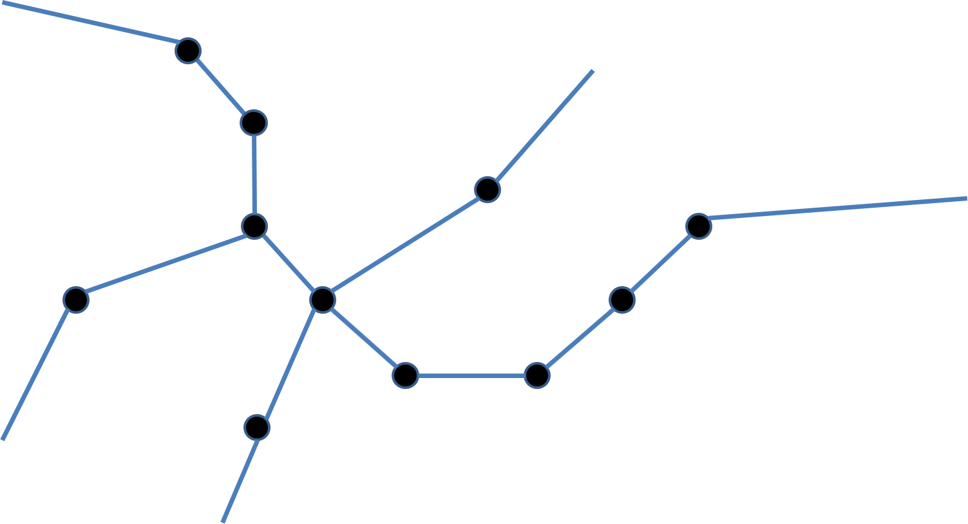
Stream networks
Imagine you have samples on a stream network

Slide 4
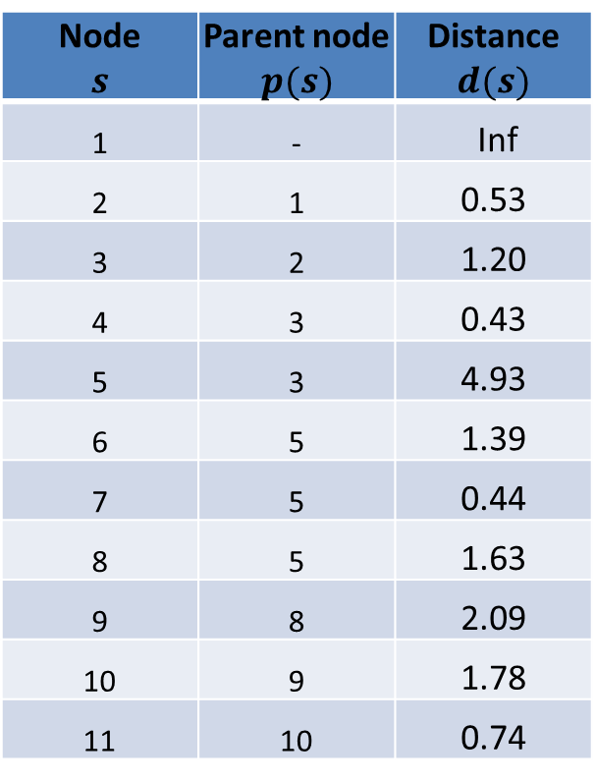
Stream networks
Define an directed acyclic graph (DAG) for network
1
Node $$s$$ | Parent node $$p(s)$$ | Distance $$d(s)$$
1 | - | Inf
2 | 1 | 0.53
3 | 2 | 1.20
4 | 3 | 0.43
5 | 3 | 4.93
6 | 5 | 1.39
7 | 5 | 0.44
8 | 5 | 1.63
9 | 8 | 2.09
10 | 9 | 1.78
11 | 10 | 0.74
11

Slide 5
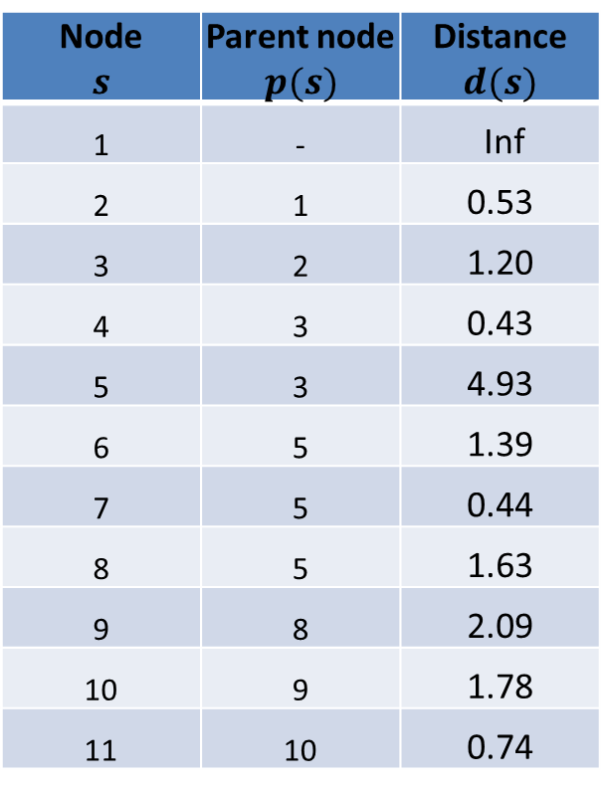
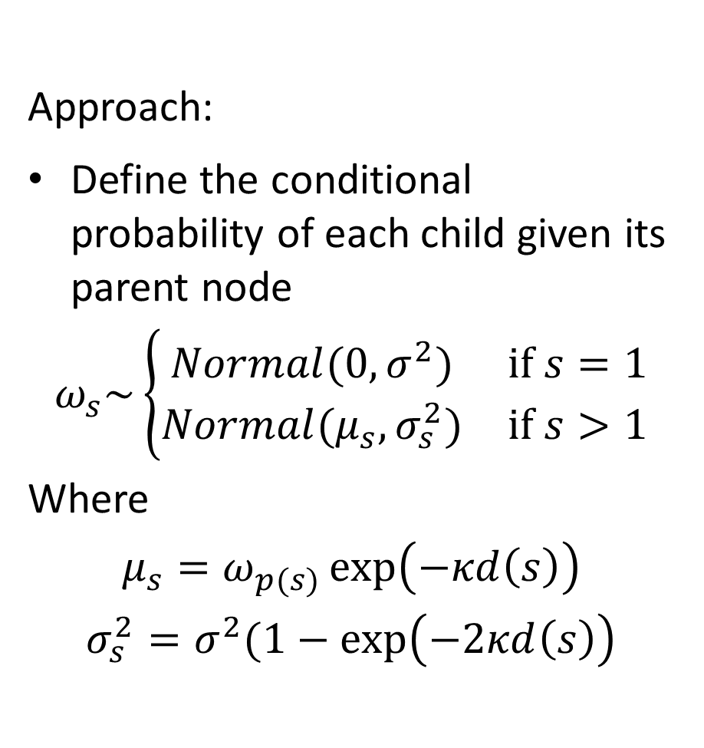
Stream networks
Define an directed acyclic graph (DAG) for network
Approach:
Define the conditional probability of each child given its parent node
$$ω_{s}\sim \left\{\begin{matrix}Normal(0,σ^{2}) & if s=1 \\ Normal(μ_{s},σ_{s}^{2}) & if s>1\end{matrix}\right.$$
Where
$$μ_{s}=ω_{p(s)}\exp\left(−κd\left(s\right)\right)$$
$$σ_{s}^{2}=σ^{2}(1−\exp\left(−2κd\left(s\right)\right)$$
Node $$s$$ | Parent node $$p(s)$$ | Distance $$d(s)$$
1 | - | Inf
2 | 1 | 0.53
3 | 2 | 1.20
4 | 3 | 0.43
5 | 3 | 4.93
6 | 5 | 1.39
7 | 5 | 0.44
8 | 5 | 1.63
9 | 8 | 2.09
10 | 9 | 1.78
11 | 10 | 0.74

Slide 6
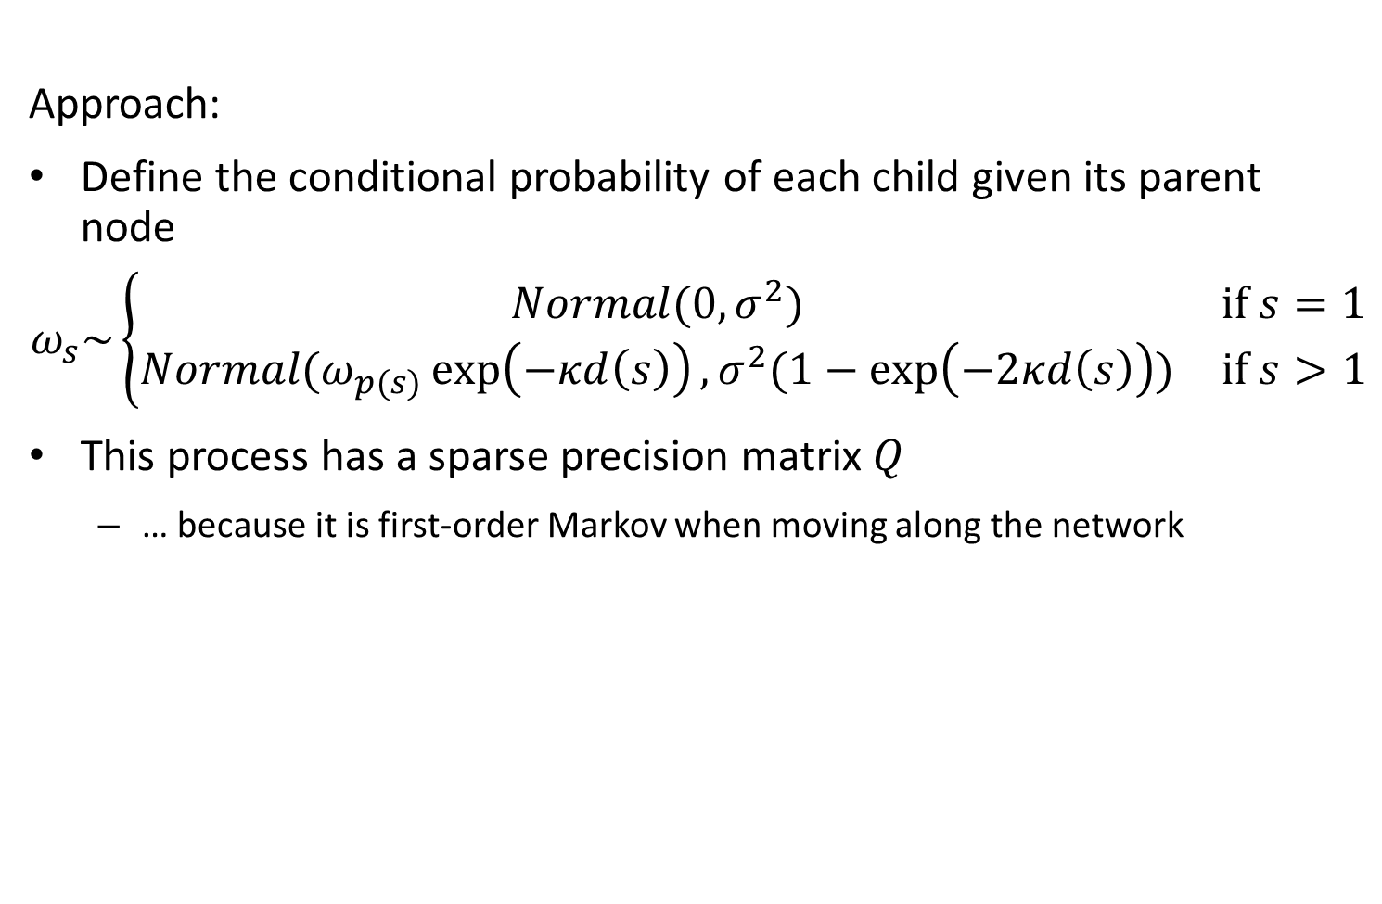
Stream networks
Approach:
Define the conditional probability of each child given its parent node
$$ω_{s}\sim \left\{\begin{matrix}Normal(0,σ^{2}) & if s=1 \\ Normal(ω_{p(s)}\exp\left(−κd\left(s\right)\right),σ^{2}(1−\exp\left(−2κd\left(s\right)\right)) & if s>1\end{matrix}\right.$$
This process has a sparse precision matrix $Q$
… because it is first-order Markov when moving along the network
Define an directed acyclic graph (DAG) for network

Slide 7
Stream networks
[see code to check Q calculation using TMB inner hessian]
Define an directed acyclic graph (DAG) for network

Slide 8
Stream networks
[see code to confirm that both approaches give same result]
Define an directed acyclic graph (DAG) for network

